Slide 1
Airbnb Price Prediction with Machine Learning
TMP 7801 Master Project: Project
24-August-2023
Prepared by: Kiu May Yee (1211405279)

Slide 2
Introduction
Airbnb
created by Brian Chesky and Joe Gebbia in year 2008.
Platform for home owners to rent out unused space.
Reasonable rental price to attract more customers in a fair marketplace, thus increase occupancy rates in Airbnb.
Price prediction model with implementation machine learning techniques can provide accurate price suggestion to property owners.

Slide 3
Introduction
Objective
Three objectives are identified in this project.
To identify the set of important features for pricing prediction
To build a price prediction model using machine learning
To evaluate the performance of the predictive model.
Scope
Latest Thailand Bangkok Airbnb dataset from Inside Airbnb.com is used.

Slide 4
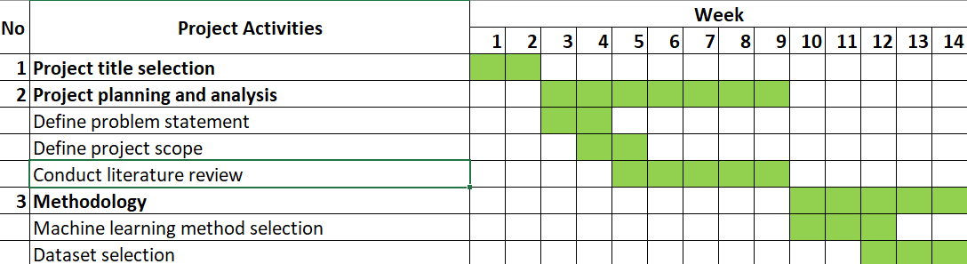
Gantt Chart for FYP-1 and FYP-2

Slide 5
Literature Review
Price Prediction Model
Price prediction for Airbnb by using machine learning techniques is popular topics, with numerous studies adopting various machine learning techniques to predict prices for Airbnb short term rentals.
Supervised techniques such as linear regression, support vector regression (SVR), random forest regression, artificial neural network (ANN), gradient boosting machine (GBM) and extreme gradient boosting (XGBoost) are widely studied.
Supervised learnings technique work well in recommendation engines and help gaining insight into customer profiles.

Slide 6
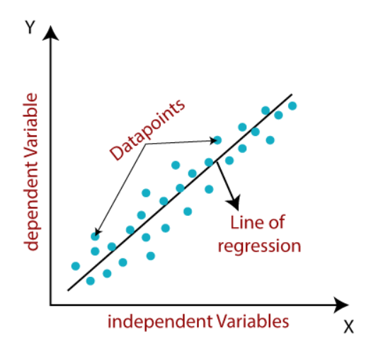
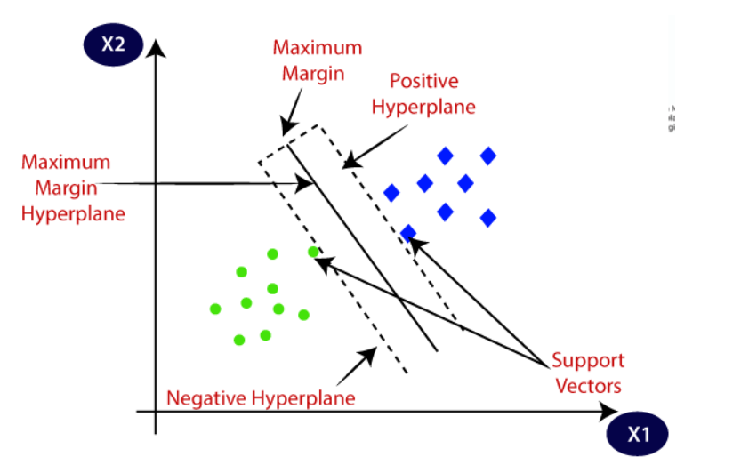
1. Linear Regression
Linear regression gives a linear model which finds the linear relationship between dependent and independent variables.
Y. Yang et al. (2016) study relationship between market accessibility and hotel prices in Caribbean with a three level mixed effect linear regression model. It is concluded hotel prices are determined by the significant independent variables- level of market accessibility, services provided by hotel and online quality signalling factors.
2. Support Vector Regression (SVR)
SVR is a classification type supervised machine learning technique, which uses the support vector machine (SVM) to predict continuous variables.
SVR fits the best line within a threshold value.
It is recommended in study of real estate price prediction models (Yu & Jiafu Wu, 2016) and Airbnb price prediction study by (Rezazadeh Kalehbasti et al., 2021).

Slide 7
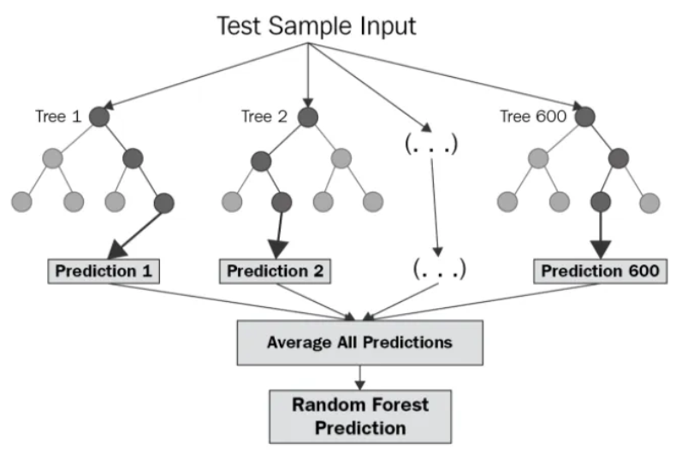
3. Random Forest Regression
Ensemble learning method by combining decision tree method with regression.
Wang & Nicolau (2017) developed a model by using random forest regression and principal component analysis to predict Airbnb listings price in New York. In this study, the model was able to achieve an average absolute error of $20.49, which is lower than other baseline models.
4. Gradient Boosting Method (GBM)
Ensemble method which combines a decision tree. Shortcomings of the weak learners are identified through gradients in the loss function which indicates the fitness of the model’s coefficients to the underlying data.
Ye et al., (2018) predicted booking probability of each listing with a binary classification model to assist property owners in setting optimal price for each listing.
Ahuja et al., (2021) combining multiple features with the use of method Light GBM in predicting Airbnb rental prices, and to improve accuracy of price prediction. Features identified in the studies including property characteristics, location and reviews by customers are impacting Airbnb rental prices.

Slide 8
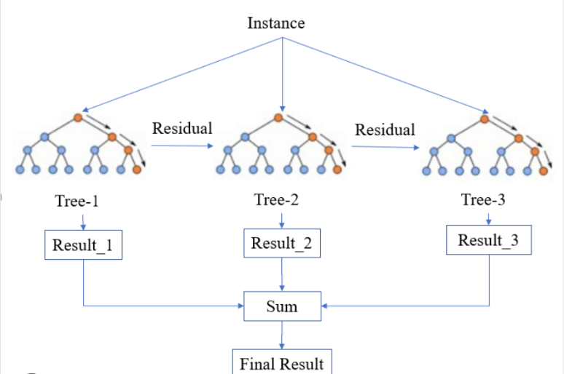
5. XGBoost
XGBoost trains faster and can be performed parallelly across clusters for datasets containing mixtures of categorical and numerical values.
Trang et al., (2021) combined XGBoost with a clustering technique k-means to predict an optimal price suggestion for property listing on Airbnb.
Kalehbasti et al., (2019) performed a study on Airbnb price prediction in Istanbul and found that using XGBoost method, price can be predicted accurately in the Istanbul area as compared to linear regression method.

Slide 9
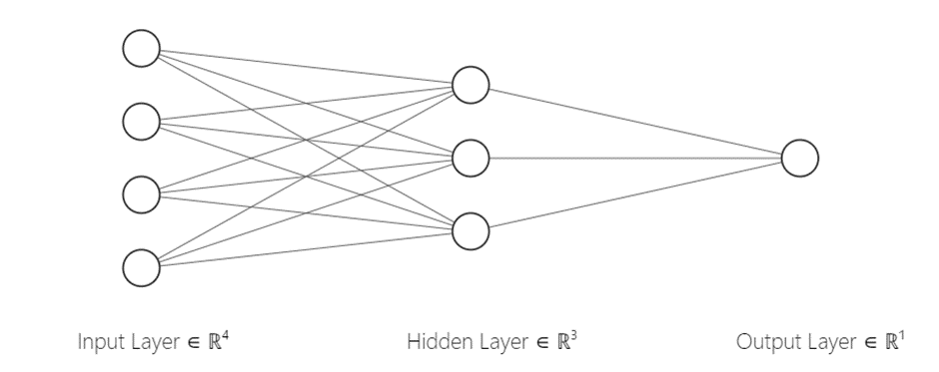
6. Artificial Neural Network (ANN)
Every node is connected to each other to feed data generated from linear regression to the activation functions.
Technique | Description
Deep neural network (DNN) | Foundation for NLP, convolutional NN and recurrent NN. Lewis (2019) compared the Airbnb price prediction model which is built by XGBoost and DNN with Airbnb London listings. Peng et al. (2020) uses NLP to extract textual comments reviewed by customers, and developed Airbnb price prediction model with 4 types of machine learning models, Linear regression, SVR, XGBoost and DNN. Pricing models built with multi-modality data increase prediction efficiency. Thakur et al.( 2022) built a DNN with L1 Regularization to predict Airbnb price in Rio de Janeiro. - property price can be set higher during warm season. - popular room type have at least a private bedroom with two separate beds and a bathroom.

Slide 10
Feature Selection
Literature Review
To select only relevant data and eliminating redundant features in the dataset.
Some of the features are more important, and shows greater correlation to the listing price.
Helps to increase the prediction power of the of the selected algorithms, and give a more robust model.
Certain algorithms have built in method to select critical features:
Lasso regression :-
select a subset of the important features while shrinking the coefficient of the others to zero (Masrom et al.(2022) and Liu (2021)).
Correlation based feature selection (CFS) :-
filter technique by calculating the correlation between each input variable to the output label. (Kirkos (2021))

Slide 11
Summary
Literature Review
Many studies applied machine learning methods to predict Airbnb price.
However, some features are redundant and may affect the performance and the generalizability of the machine learning algorithms.
Although some studies did apply feature selection, they may not be effective to identify the set of informative features.
Rather than applying feature selection separately before the modelling process, we applied an implicit feature selection that incorporates feature selection within the modelling process.

Slide 12
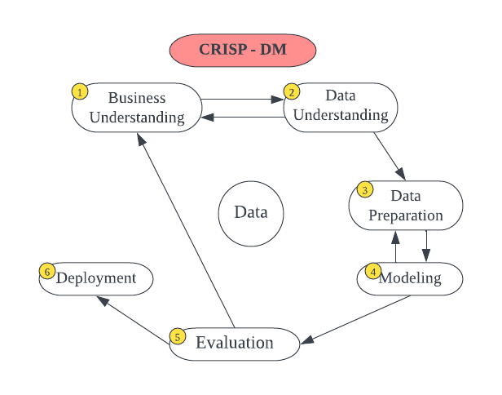
Methodology : CRISP-DM
Business understanding: assess situation and identify research gaps literature review, identify goals, problem statement, define project plan – Gantt Chart.
Data understanding: collect data – Thailand Airbnb listing data, explore and understanding the detail of dataset.
Data preparation: perform data cleaning, construct/transform data into format that is suitable for the machine learning training. Split dataset into training set and evaluation set.
Modeling: select different modelling technique to use, build test case, build model and assess model.
Evaluation: evaluate price prediction model with evaluation dataset. Analyze with metrics: R2, root mean square error (RMSE), mean absolute error (MAE).

Slide 13
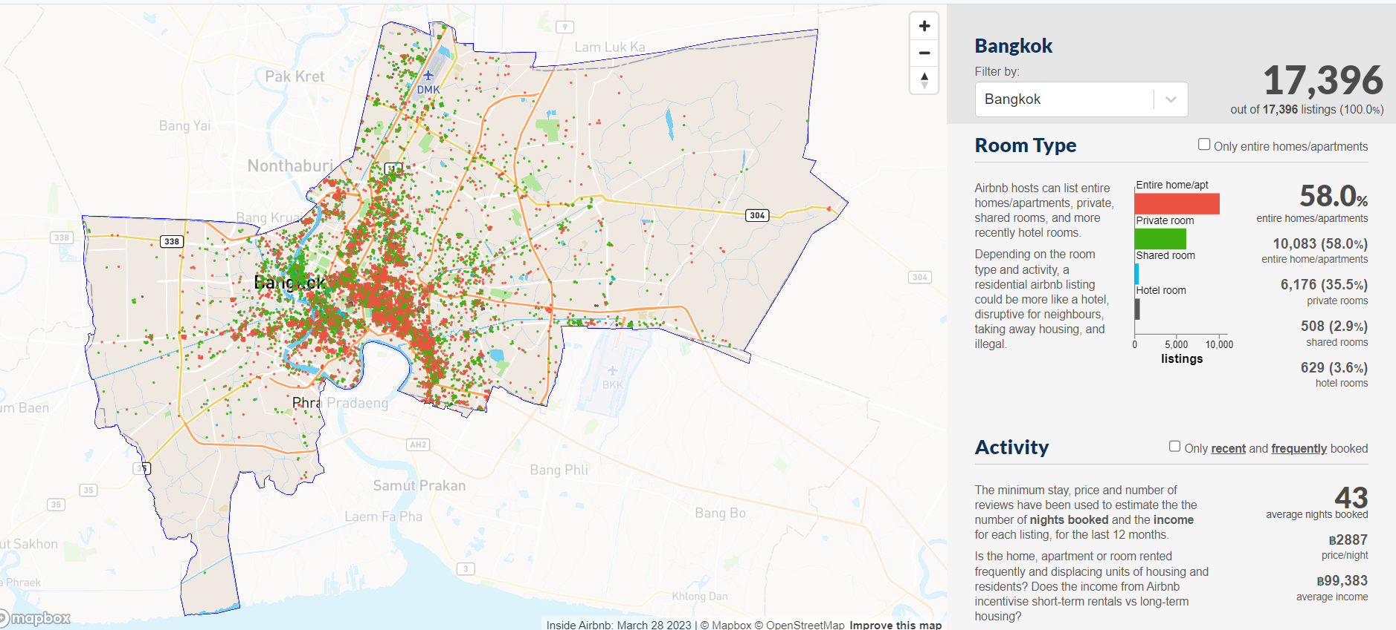
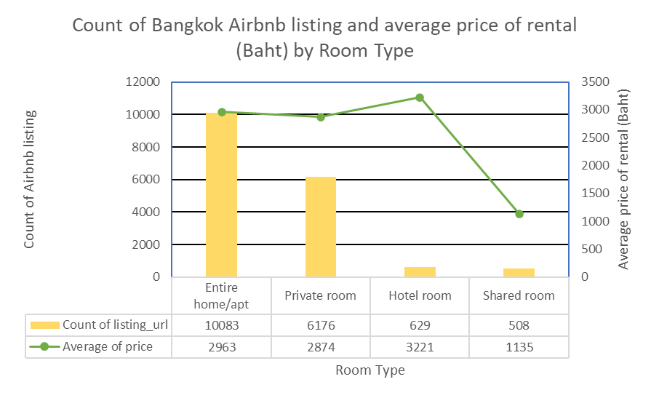
Dataset Analysis
In Bangkok, as of Mar’2023 :17,936 accommodations are listed on Airbnb.

Slide 14
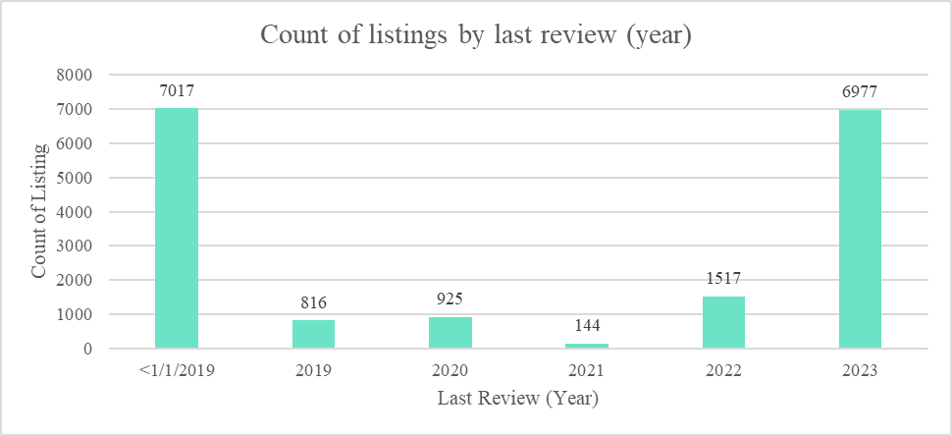
Data Exploration
7,833/17,936 listings – last review back in year 2019.

Slide 15
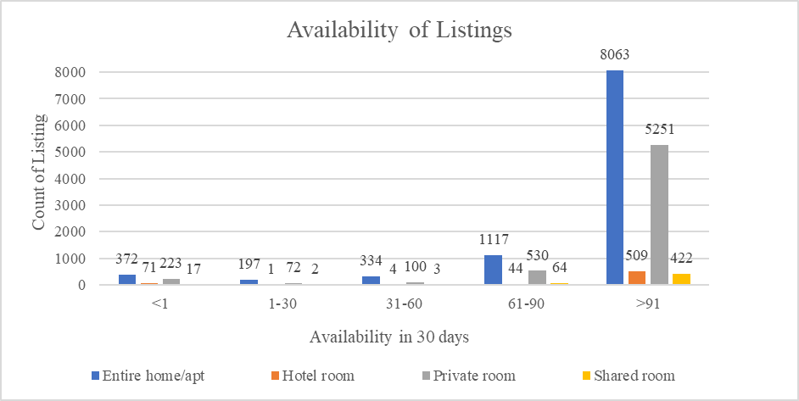
Data Exploration
14,245/17,936 listings have an availability of more than 90 days.

Slide 16
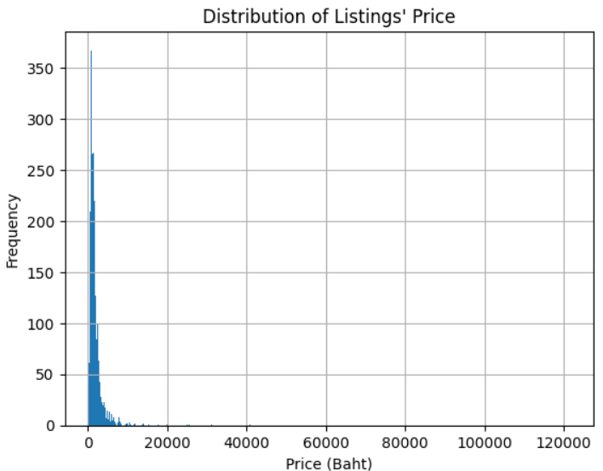
Data Exploration
Price of listings is skewed. Log transformation is applied.

Slide 17
Data Preprocessing
Data field is filtered out if:
Duplicated data field: eg: calendar last scrapped, bathrooms, etc.
Irrelevant data field: eg: host picture url, picture url, scrape id, first review, calculated_host_listings_count, etc.
Most of the value missing: eg: neighbourhood group cleansed, calendar_updated, license, etc.
27 data fields are remained.
Data rows is filtered out:
Rows with empty cells are removed.
Last reviewed data is older than year 2020.
4,123 data rows are remained.
Data types are converted to numbers (type: float64).
For categorical data field: converted to integer.

Slide 18
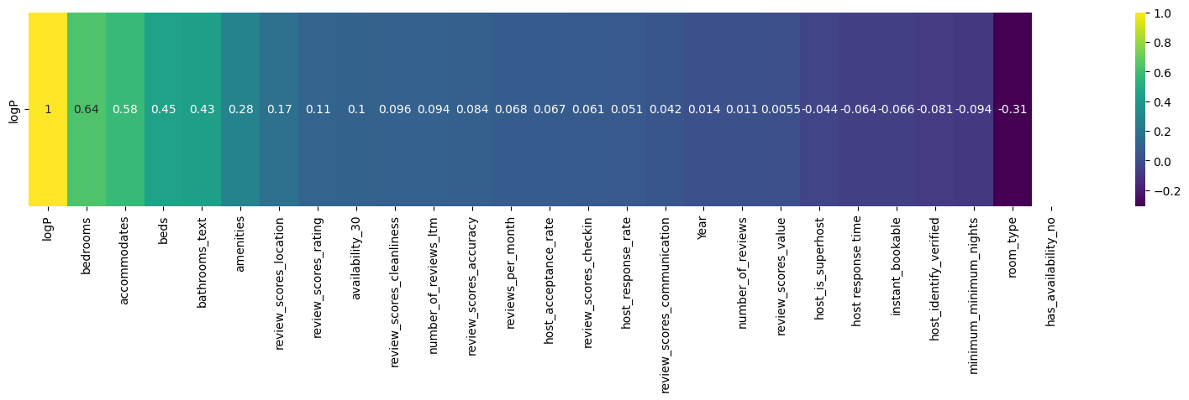
Feature Analysis – Heat Map
Used to understand which features have positively or negatively correlated to target variable.

Slide 19
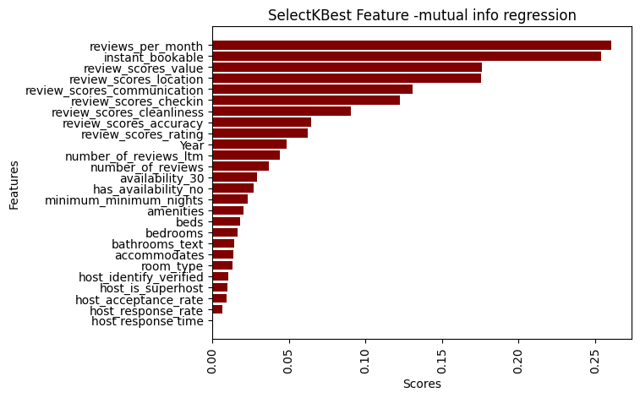
Feature Analysis - SelectKBest
Scoring function – mutual info regression is used.
Greater scores – more impactful to accuracy of the prediction model.

Slide 20
Feature Selection – Lasso Regression
L1 penalty is applied to prediction model.
Applied to linear regression model, neural network model, and bagging regression model, which does not have implicit feature selection function.
Top 5 significant features by comparing the coefficient value:
Reviews_per_month,
Instant_bookable,
Review_scores_value,
review_scores_location,
review_scores_communication,

Slide 21
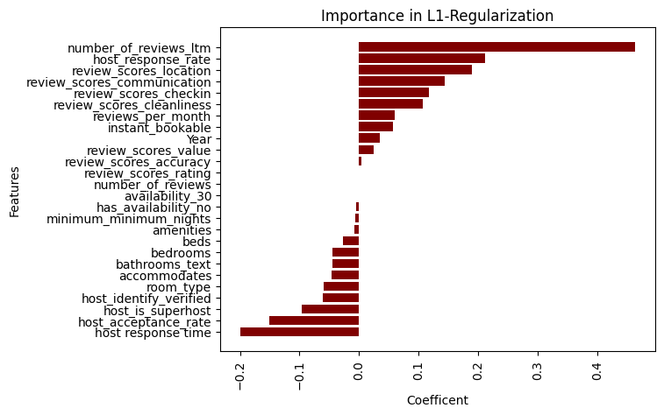
Feature Selection – Lasso Regression
Features with positive relationship: number of reviews_ltm, host response rate, review_scores_location
Features with negative relationship: host response time, host_acceptance rate, host_is_superhost
0: number_of_reviews

Slide 22
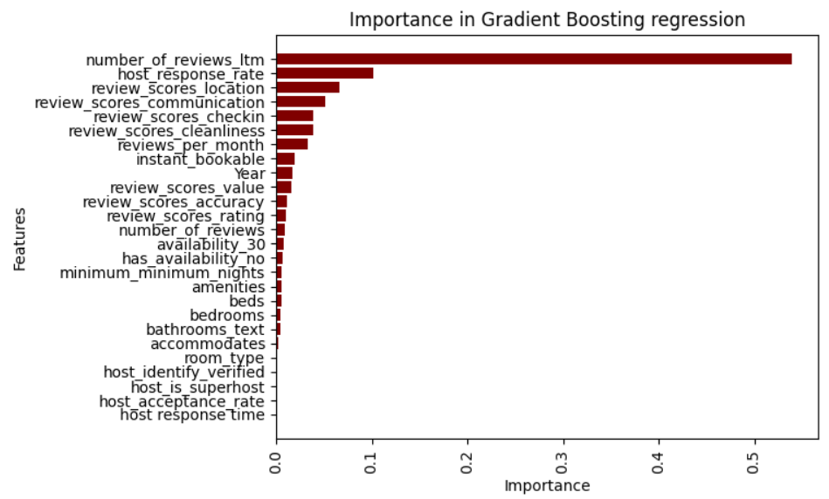
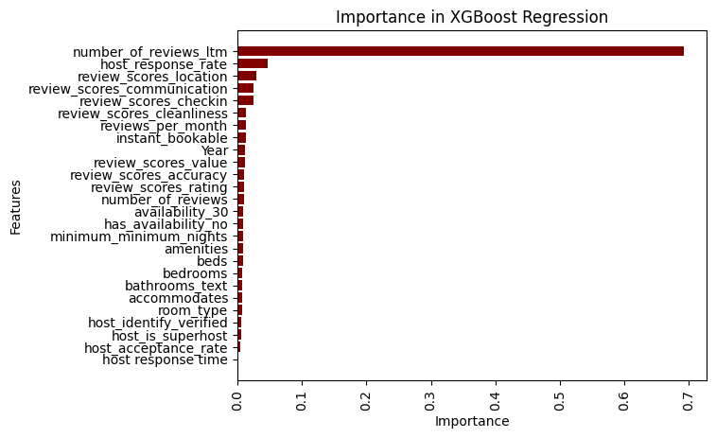
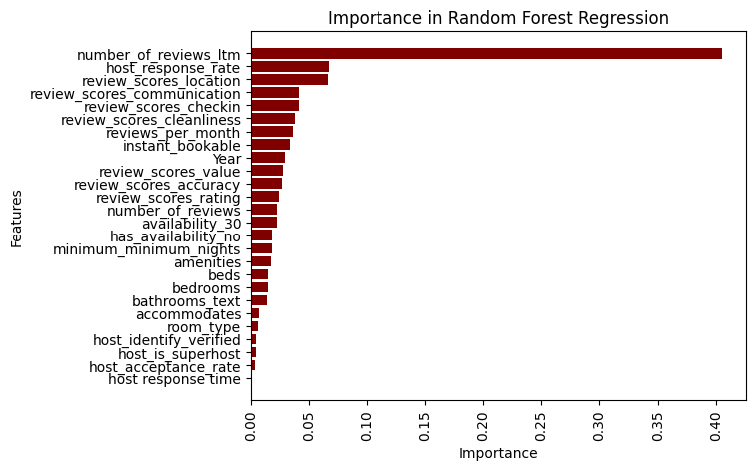
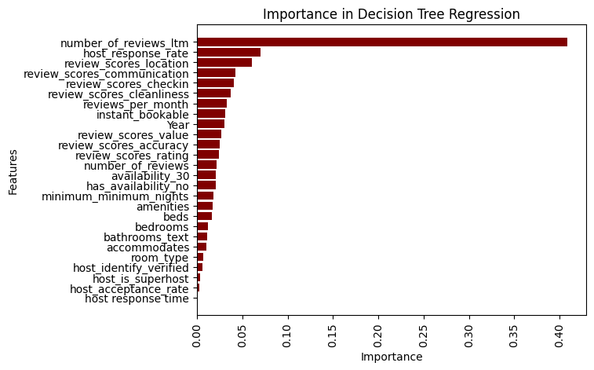
Implicit Feature Selection
Importance score = 0: no relationship between feature and target variable.
Top pareto of important features according to the attributes (feature_importances_):
number of reviews ltm,
host response rate
Review_scores_location,
review score communication
Review_scores_checkin

Slide 23
Cross Validation
5-fold cross validation technique is used to split the dataset into five subsets of data.
Model is trained and evaluated, with desired machine learning technique:
Linear regression
Neural network
Bagging regression
Gradient boosting regression
XGBoosting regression
Decision tree regression
Random forest regression
Metrics: Mean absolute error (MAE), R², Root mean squared error (RMSE)

Slide 24
Performance Metric Evaluation
Model | Without L1-Regularization |  |  | With L1- Regularization
 | MAE | R2 | RMSE | λ | MAE | R2 | RMSE
Linear Regression | 0.5146 | 0.5419 | 0.6721 | 0.0030 | 0.5142 | 0.5423 | 0.6717
Bagging regression | 0.4854 | 0.5665 | 0.6537 | 0.0030 | 0.5146 | 0.5418 | 0.6721
 |  |  |  | Alpha | MAE | R2 | RMSE
Neural Network | 0.5810 | 0.3986 | 0.7691 | 0.0030 | 0.5693 | 0.4256 | 0.7529
With L1-Regularization: Linear regression performs better with better R2 and lower error.

Slide 25
Performance Metric Evaluation
Model | MAE | R2 | RMSE
Gradient Boosting regression | 0.4938 | 0.5738 | 0.6481
Decision tree regression | 0.6977 | 0.1145 | 0.9324
Random Forest Regression | 0.4890 | 0.5718 | 0.6490
XGBoost | 0.5074 | 0.5458 | 0.6693
Gradient boosting regression performs the best with R2 = 0.5738 and lowest RMSE = 0.6481

Slide 26
Conclusion
Gradient boosting regression model gives the best accuracy with MAE 0.4938, R2 score 0.5738 and RMSE 0.6481.
Important features that can impact the price of Airbnb listing:
number of reviews,
location of the Airbnb listing,
cleanliness of the listing,
Communication of host with customers,
host response rate of an Airbnb listing and host as a superhost.

Slide 27
Future Work
In current work, all the models were trained with default parameters without any performance tuning.
For future work includes
performing hyper-parameter tuning
combine textual features such as customer reviews, neighbourhood overview, amenities and etc. to evaluate if such features can further improve the price prediction.

Slide 28
Thank You.

